Slide 1

22년 삼성 AI 전문가과정
6월 8일 수요일 1교시
장병탁
인공지능
8차시 : Knowledge Representation
서울대학교 컴퓨터공학부
담당 교수: 장병탁
Seoul National University
Byoung-Tak Zhang

Slide 2
Lecture Overview
인공지능
8차시 : Knowledge Representation
서울대학교 컴퓨터공학부
담당 교수: 장병탁
Seoul National University
Byoung-Tak Zhang

Slide 3
Introduction
Knowledge-Based Agents (Previous lectures)
How an agent with a knowledge base can make inferences that enable it to act appropriately
Knowledge Representation (This lecture)
What content to put into such an agent’s knowledge base—how to represent facts about the world in a form that can be used to reason and solve problems
First-order logic
Semantic networks
Scripts, frames
Later Lectures …..
Different representation formalisms such as hierarchical task networks for reasoning about plans (Ch 11), Bayesian networks for reasoning with uncertainty (Ch 13), Markov models for reasoning over time (Ch 16), and deep neural networks for reasoning about images, sounds, and other data (Ch 22)

Slide 4
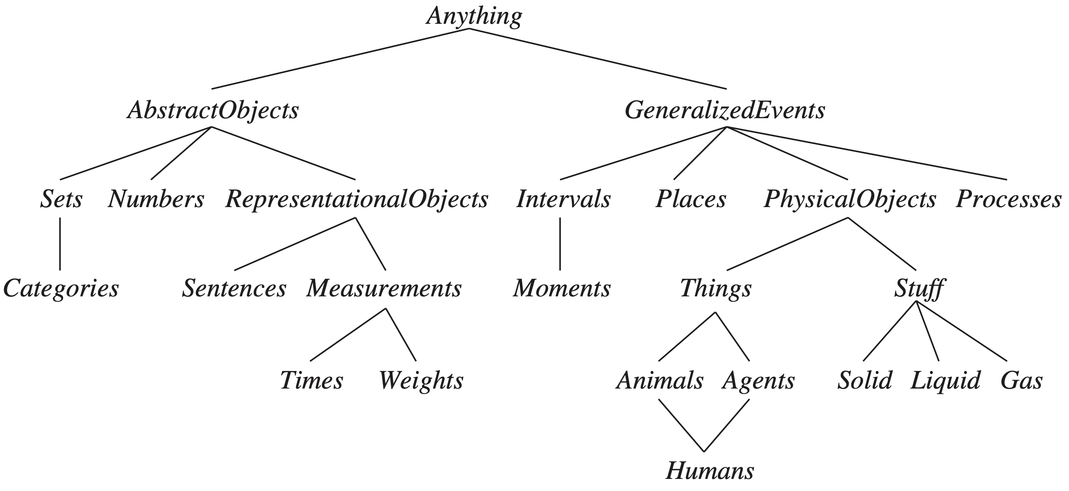

Ontological Engineering
Representing abstract concepts such as Events, Time, Physical Objects, and Beliefs that occur in many different domains
$b∈Butter∧PartOf(p,b)⇒p∈Butter$
$b∈Butter⇒MeltingPoint(b,Centigrade(30))$
$$PartOf(x, y) ∧ PartOf\left(y, z\right)⇒ PartOf(x, z), PartOf(x, x)$$
General concepts
Specific concepts
출처: Stuart J. Russell and Peter Norvig (2021). Artificial Intelligence: A Modern Approach (4rd Edition). Pearson

Slide 5
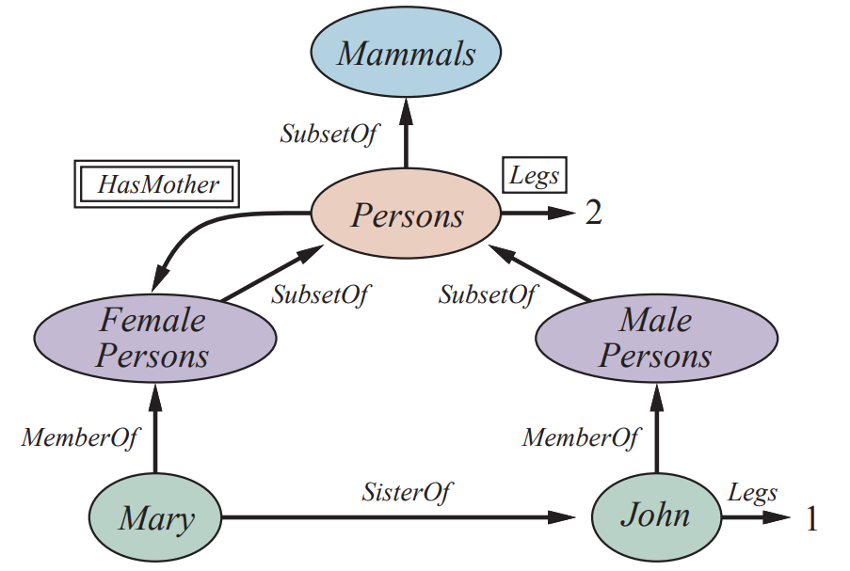
Semantic Networks
Semantic Networks
Graphical notation with underlying logical representation
A form of logic, but not FOL
Capable of representing objects, categories, and relations among objects, etc.
Convenient representation of inheritance, multiple inheritance (sometimes)
출처: Stuart J. Russell and Peter Norvig (2021). Artificial Intelligence: A Modern Approach (4rd Edition). Pearson

Slide 6

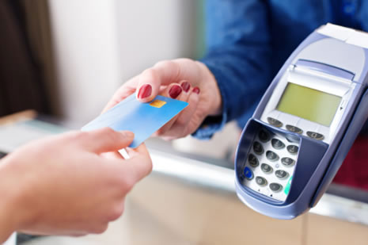
Script
EAT-AT-RESTAURANT Script
Props: (Restaurant, Money, Food, Menu, Tables, Chairs)
Roles: (Hungry-Persons, Wait-Persons, Chef-Persons)
Point-of-View: Hungry-Persons
Time-of-Occurrence: (Times-of-Operation of Restaurant)
Place-of-Occurrence: (Location of Restaurant)
Event-Sequence:
first: Enter-Restaurant Script
then: if (Wait-To-Be-Seated-Sign or Reservations)
then Get-Maitre-d's-Attention Script
then: Please-Be-Seated Script
then: Order-Food-Script
then: Eat-Food-Script unless (Long-Wait) when Exit-Restaurant-Angry Script
then: if (Food-Quality was better than Palatable)
then Compliments-To-The-Chef Script
then: Pay-For-It-Script
finally: Leave-Restaurant Script
Order-Food-Script
Pay-For-It-Script

Slide 7
Outline (Lecture 8)
8.1 Ontological Engineering .....................................
8.2 Categories and Objects .......................................
8.3 Events .................................................................
8.4 Mental Objects and Modal Logic .......................
8.5 Reasoning Systems for Categories .....................
8.6 Reasoning with Default Information ..................
Summary ...................................................................
7
11
17
22
26
35
40

Slide 8
8.1 Ontological Engineering

Slide 9
8.1 Ontological Engineering (1/3)
Knowledge Representation (KR)
How to represent diverse facts about the real world in a form that can be used to reason and solve problems
First-order logic, Bayesian networks, Markov models, deep neural networks, etc.
No matter what representation you use - the facts about the world need to be handled
Ontological Engineering
Representing abstract concepts such as Events, Time, Physical Objects, and Beliefs that occur in many different domains
Leave placeholders where new knowledge for any domain can fit in
e.g. define what it means to be a physical object, and the details of different types of objects—robots, televisions, books, or whatever—can be filled in later

Slide 10
8.1 Ontological Engineering (2/3)
Upper ontology
General framework of concepts
General concepts
Specific concepts
출처: Stuart J. Russell and Peter Norvig (2021). Artificial Intelligence: A Modern Approach (4rd Edition). Pearson

Slide 11
8.1 Ontological Engineering (3/3)
Special-purpose ontology
Designed to represent a specific domain of knowledge
Open Biomedical Ontology
General-purpose ontology
Should be applicable in any special-purpose domain
Different areas of knowledge must be unified
Example:
CYC: created by a team of trained ontologists
DBPEDIA: created by importing categories, attributes, and values from an existing database
Google Knowledge Graph: uses semistructured content from Wikipedia, combining it with other content gathered from across the web under human curation. It contains over 70 billion facts

Slide 12
8.2 Categories and Objects

Slide 13
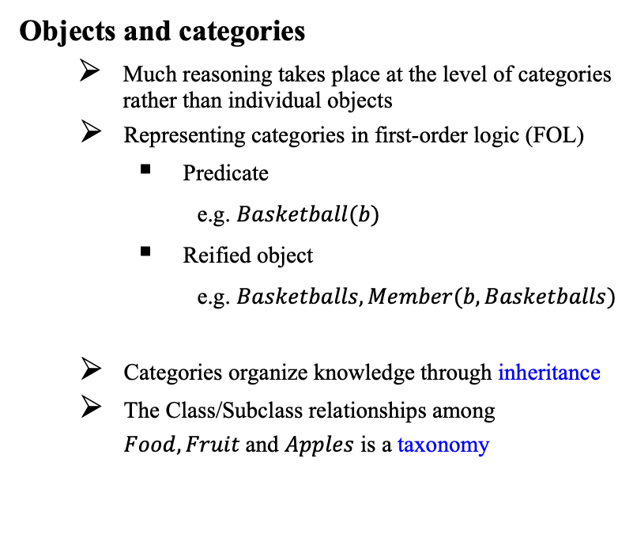
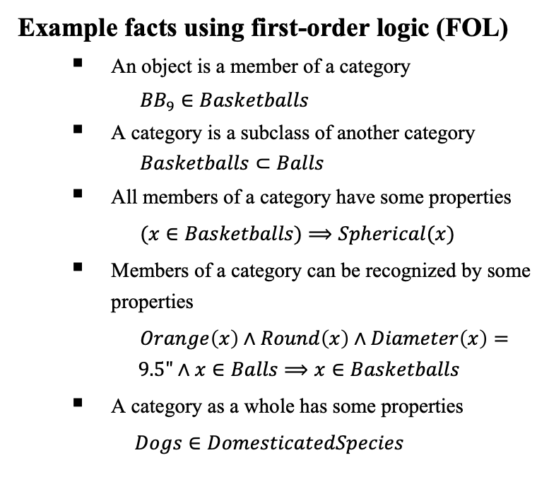
8.2 Categories and Objects (1/5)
Objects and categories
Much reasoning takes place at the level of categories rather than individual objects
Representing categories in first-order logic (FOL)
Predicate
e.g. $Basketball(b)$
Reified object
e.g. $Basketballs, Member(b, Basketballs)$
Categories organize knowledge through inheritance
The Class/Subclass relationships among $Food, Fruit$and $Apples$ is a taxonomy
Example facts using first-order logic (FOL)
An object is a member of a category
${BB}_{9}∈Basketballs$
A category is a subclass of another category
$Basketballs⊂Balls$
All members of a category have some properties
$(x∈Basketballs)⟹Spherical(x)$
Members of a category can be recognized by some properties
$Orange\left(x\right)∧Round\left(x\right)∧Diameter\left(x\right)=$ $9.5"∧x∈Balls⟹x∈Basketballs$
A category as a whole has some properties
$Dogs∈DomesticatedSpecies$

Slide 14
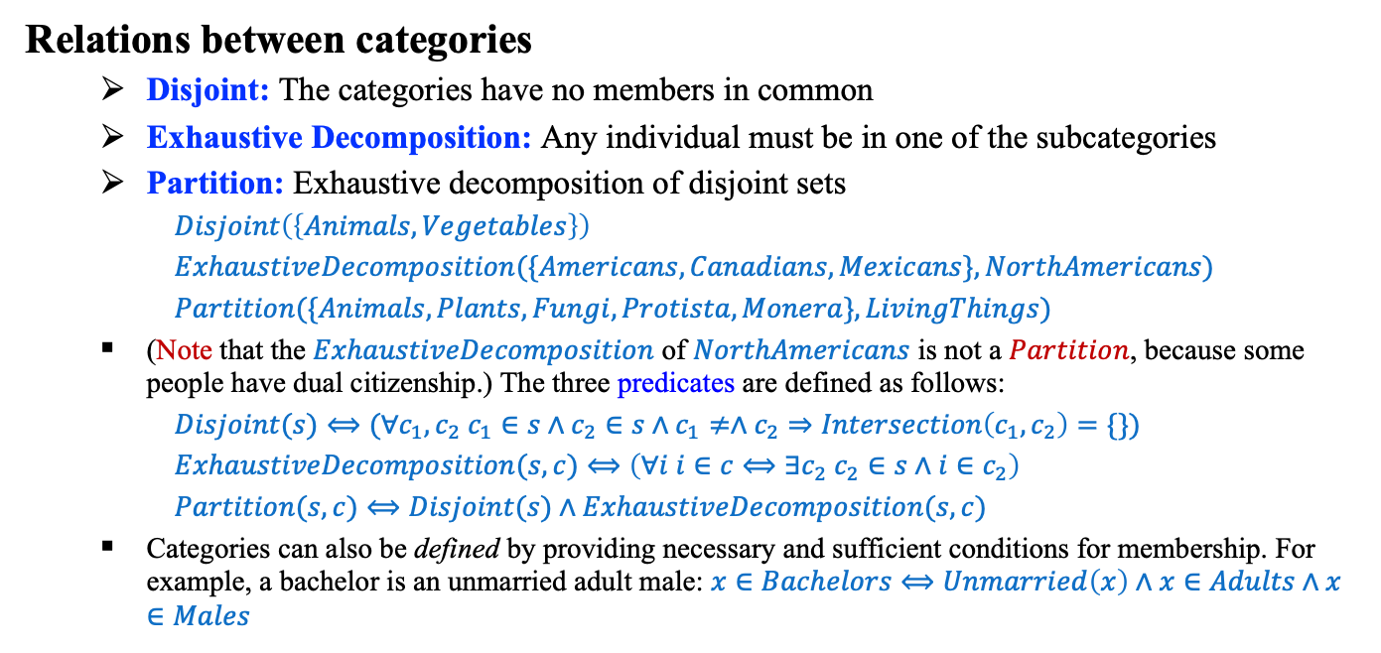
8.2 Categories and Objects (2/5)
Relations between categories
Disjoint: The categories have no members in common
Exhaustive Decomposition: Any individual must be in one of the subcategories
Partition: Exhaustive decomposition of disjoint sets
$Disjoint\left(\left\{Animals, Vegetables\right\}\right)$
$ExhaustiveDecomposition(\{Americans,Canadians,Mexicans\}, NorthAmericans)$
$Partition(\{Animals,Plants,Fungi,Protista,Monera\}, LivingThings)$
(Note that the $ExhaustiveDecomposition$ of $NorthAmericans$ is not a $Partition$, because some people have dual citizenship.) The three predicates are defined as follows:
$Disjoint(s)⟺(∀c_{1},c_{2} c_{1}∈s∧c_{2}∈s∧c_{1}≠∧c_{2}⇒Intersection\left(c_{1},c_{2}\right)=\{\})$
$ExhaustiveDecomposition(s,c)⟺\left(∀i i∈c⟺∃c_{2} c_{2}∈s∧i∈c_{2}\right)$
$Partition(s,c)⟺Disjoint(s)∧ExhaustiveDecomposition(s,c)$
Categories can also be defined by providing necessary and sufficient conditions for membership. For example, a bachelor is an unmarried adult male: $x∈Bachelors⟺Unmarried\left(x\right)∧x∈Adults∧x∈Males$

Slide 15
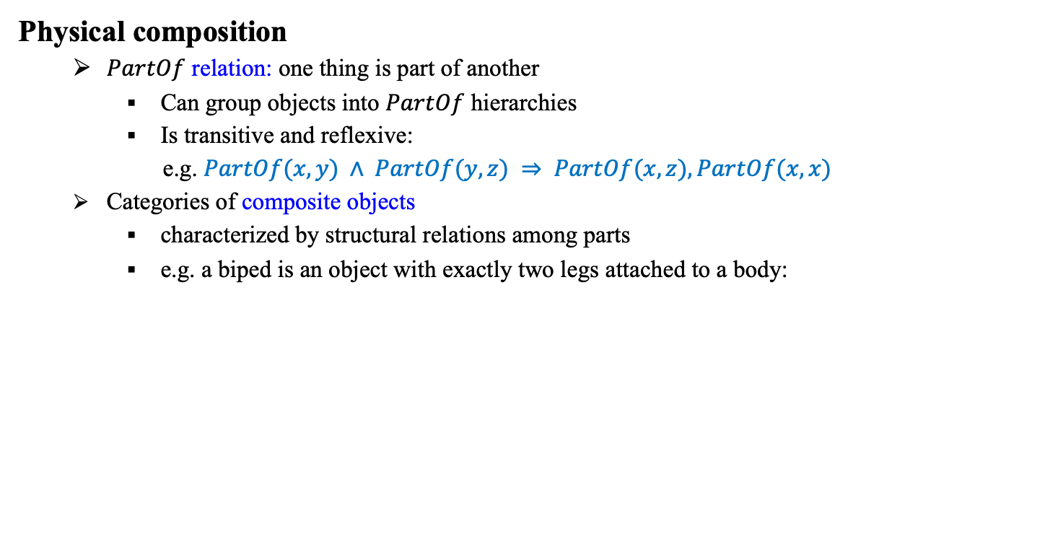

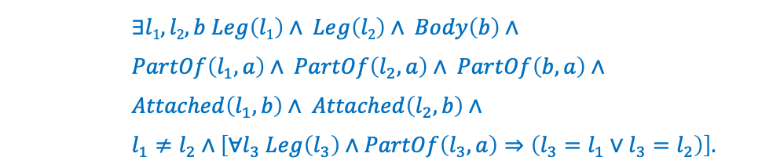
8.2 Categories and Objects (3/5)
Physical composition
$PartOf$ relation: one thing is part of another
Can group objects into $PartOf$ hierarchies
Is transitive and reflexive:
e.g. $PartOf(x, y) ∧ PartOf(y, z) ⇒ PartOf(x, z), PartOf(x, x)$
Categories of composite objects
characterized by structural relations among parts
e.g. a biped is an object with exactly two legs attached to a body:
$∃l1, l2, b Leg\left(l1\right)∧ Leg\left(l2\right)∧ Body\left(b\right)∧$
$PartOf\left(l_{1},a\right)∧ PartOf\left(l_{2},a\right)∧ PartOf\left(b,a\right)∧$
$Attached\left(l_{1},b\right)∧ Attached\left(l_{2},b\right)∧$
$l_{1}≠l_{2}∧\left[∀l_{3} Leg\left(l_{3}\right)∧PartOf\left(l_{3},a\right)⇒\left(l_{3}=l_{1}∨l_{3}=l_{2}\right)\right].$
$$Biped\left(a\right) ⇒$$

Slide 16
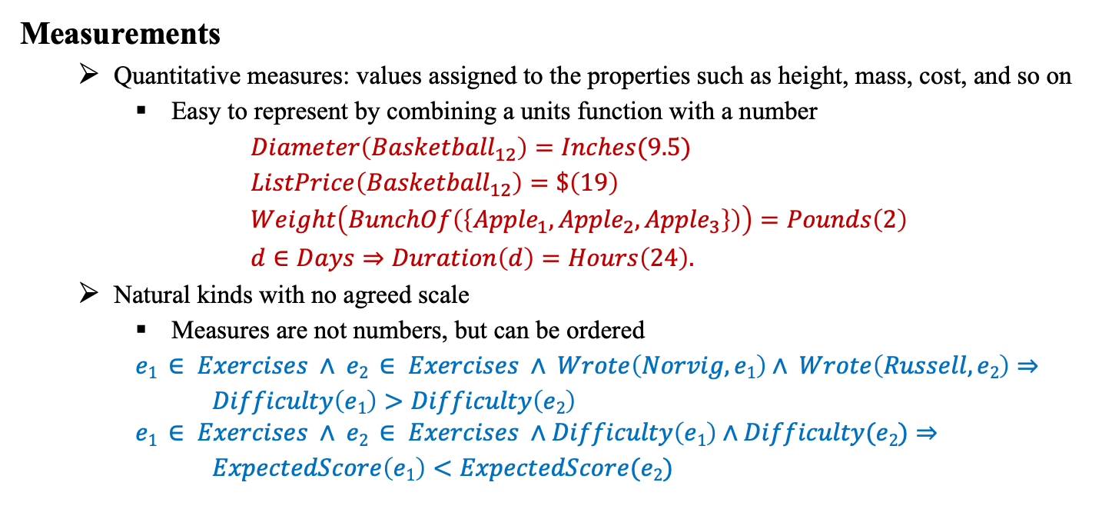
8.2 Categories and Objects (4/5)
Measurements
Quantitative measures: values assigned to the properties such as height, mass, cost, and so on
Easy to represent by combining a units function with a number
$Diameter\left({Basketball}_{12}\right)=Inches(9.5)$
$ListPrice\left({Basketball}_{12}\right)=\$\left(19\right)$
$Weight\left(BunchOf\left(\left\{{Apple}_{1},{Apple}_{2},{Apple}_{3}\right\}\right)\right)=Pounds\left(2\right)$
$d∈Days⇒Duration\left(d\right)=Hours\left(24\right).$
Natural kinds with no agreed scale
Measures are not numbers, but can be ordered
$e1 ∈ Exercises ∧ e2 ∈ Exercises ∧ Wrote\left(Norvig, e1\right)∧ Wrote\left(Russell, e2\right)⇒$
$Difficulty\left(e1\right)>Difficulty\left(e2\right)$
$$e1 ∈ Exercises ∧ e2 ∈ Exercises ∧Difficulty\left(e1\right)∧Difficulty(e2)⇒$$
$ExpectedScore\left(e1\right)<ExpectedScore(e2)$

Slide 17
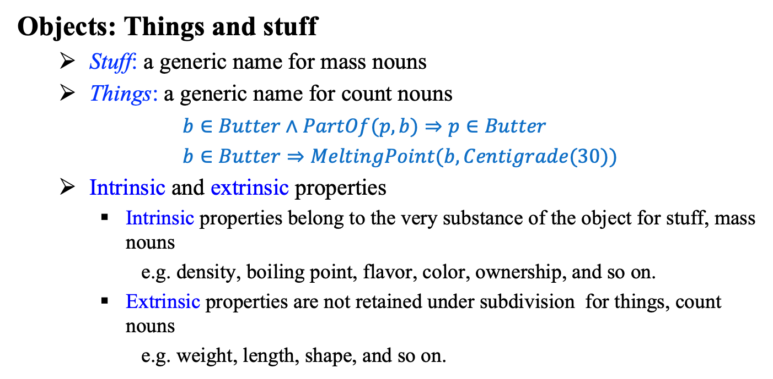
8.2 Categories and Objects (5/5)
Objects: Things and stuff
Stuff: a generic name for mass nouns
Things: a generic name for count nouns
$b∈Butter∧PartOf(p,b)⇒p∈Butter$
$b∈Butter⇒MeltingPoint(b,Centigrade(30))$
Intrinsic and extrinsic properties
Intrinsic properties belong to the very substance of the object for stuff, mass nouns
e.g. density, boiling point, flavor, color, ownership, and so on.
Extrinsic properties are not retained under subdivision for things, count nouns
e.g. weight, length, shape, and so on.

Slide 18
8.3 Events

Slide 19
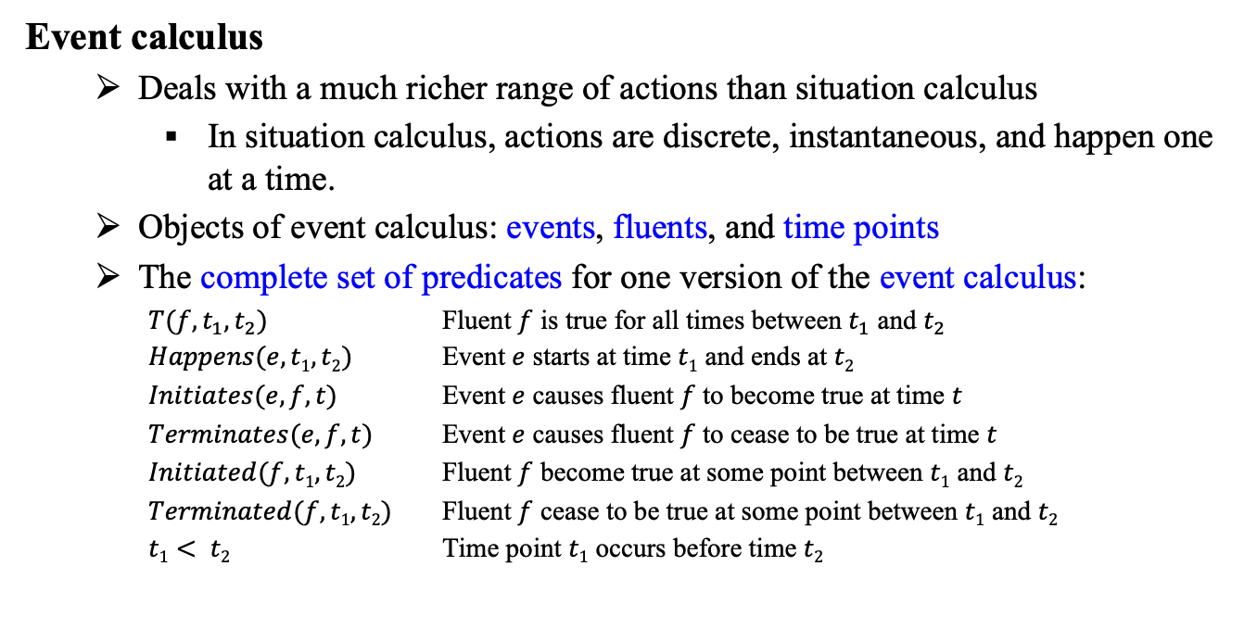
8.3 Events (1/3)
Event calculus
Deals with a much richer range of actions than situation calculus
In situation calculus, actions are discrete, instantaneous, and happen one at a time.
Objects of event calculus: events, fluents, and time points
The complete set of predicates for one version of the event calculus:
$T(f,t_{1},t_{2})$ Fluent $f$ is true for all times between $t_{1}$ and $t_{2}$
$Happens(e, t1,t2)$ Event $e$ starts at time $t1$ and ends at $t2$
$Initiates(e, f, t)$ Event $e$ causes fluent $f$ to become true at time $t$
$Terminates(e, f, t)$ Event $e$ causes fluent $f$ to cease to be true at time $t$
$Initiated(f,t1,t2)$ Fluent $f$ become true at some point between $t1$ and $t2$
$Terminated(f,t1,t2)$ Fluent $f$ cease to be true at some point between $t1$ and $t2$
$t1< t2$ Time point $t1$ occurs before time $t2$

Slide 20
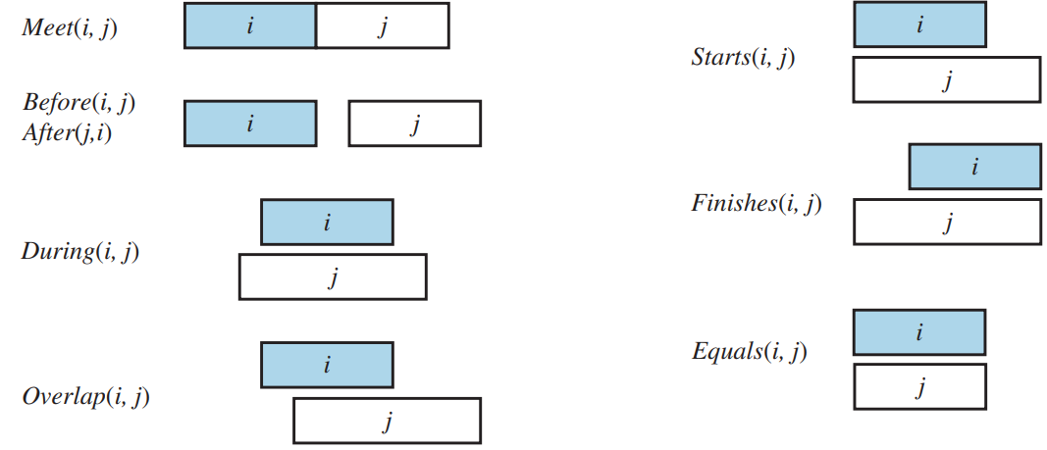
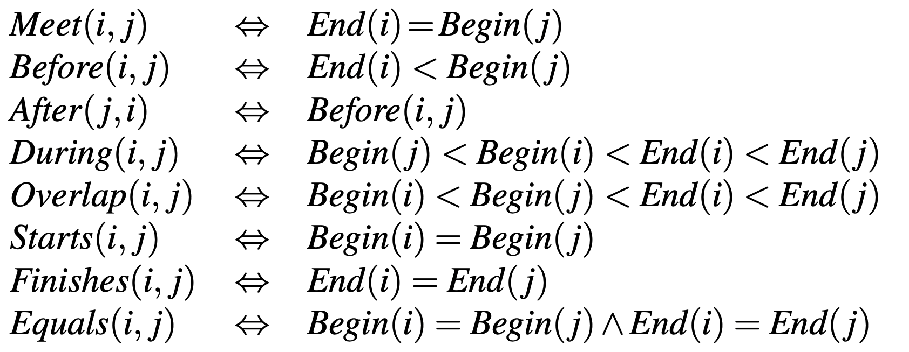
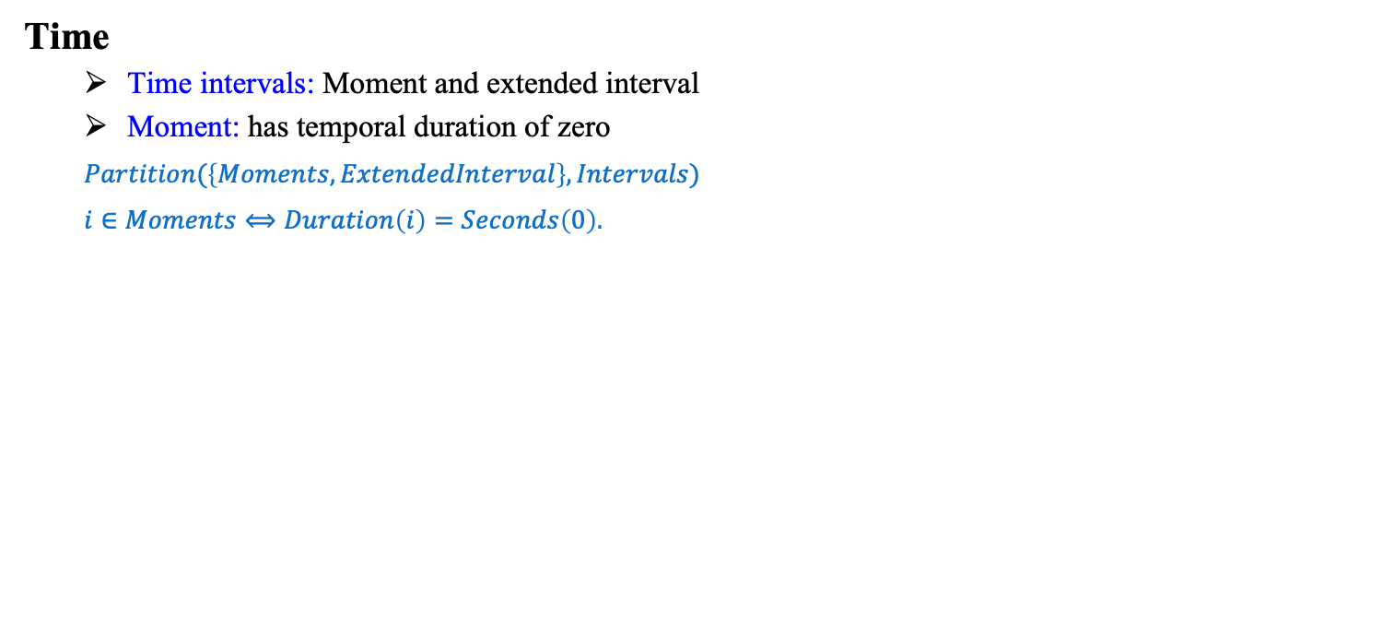
8.3 Events (2/3)
Time
Time intervals: Moment and extended interval
Moment: has temporal duration of zero
$Partition(\left\{Moments,ExtendedInterval\right\},Intervals)$
$i∈Moments⟺Duration\left(i\right)=Seconds\left(0\right).$
Predicates on time intervals
출처: Stuart J. Russell and Peter Norvig (2021). Artificial Intelligence: A Modern Approach (4rd Edition). Pearson

Slide 21
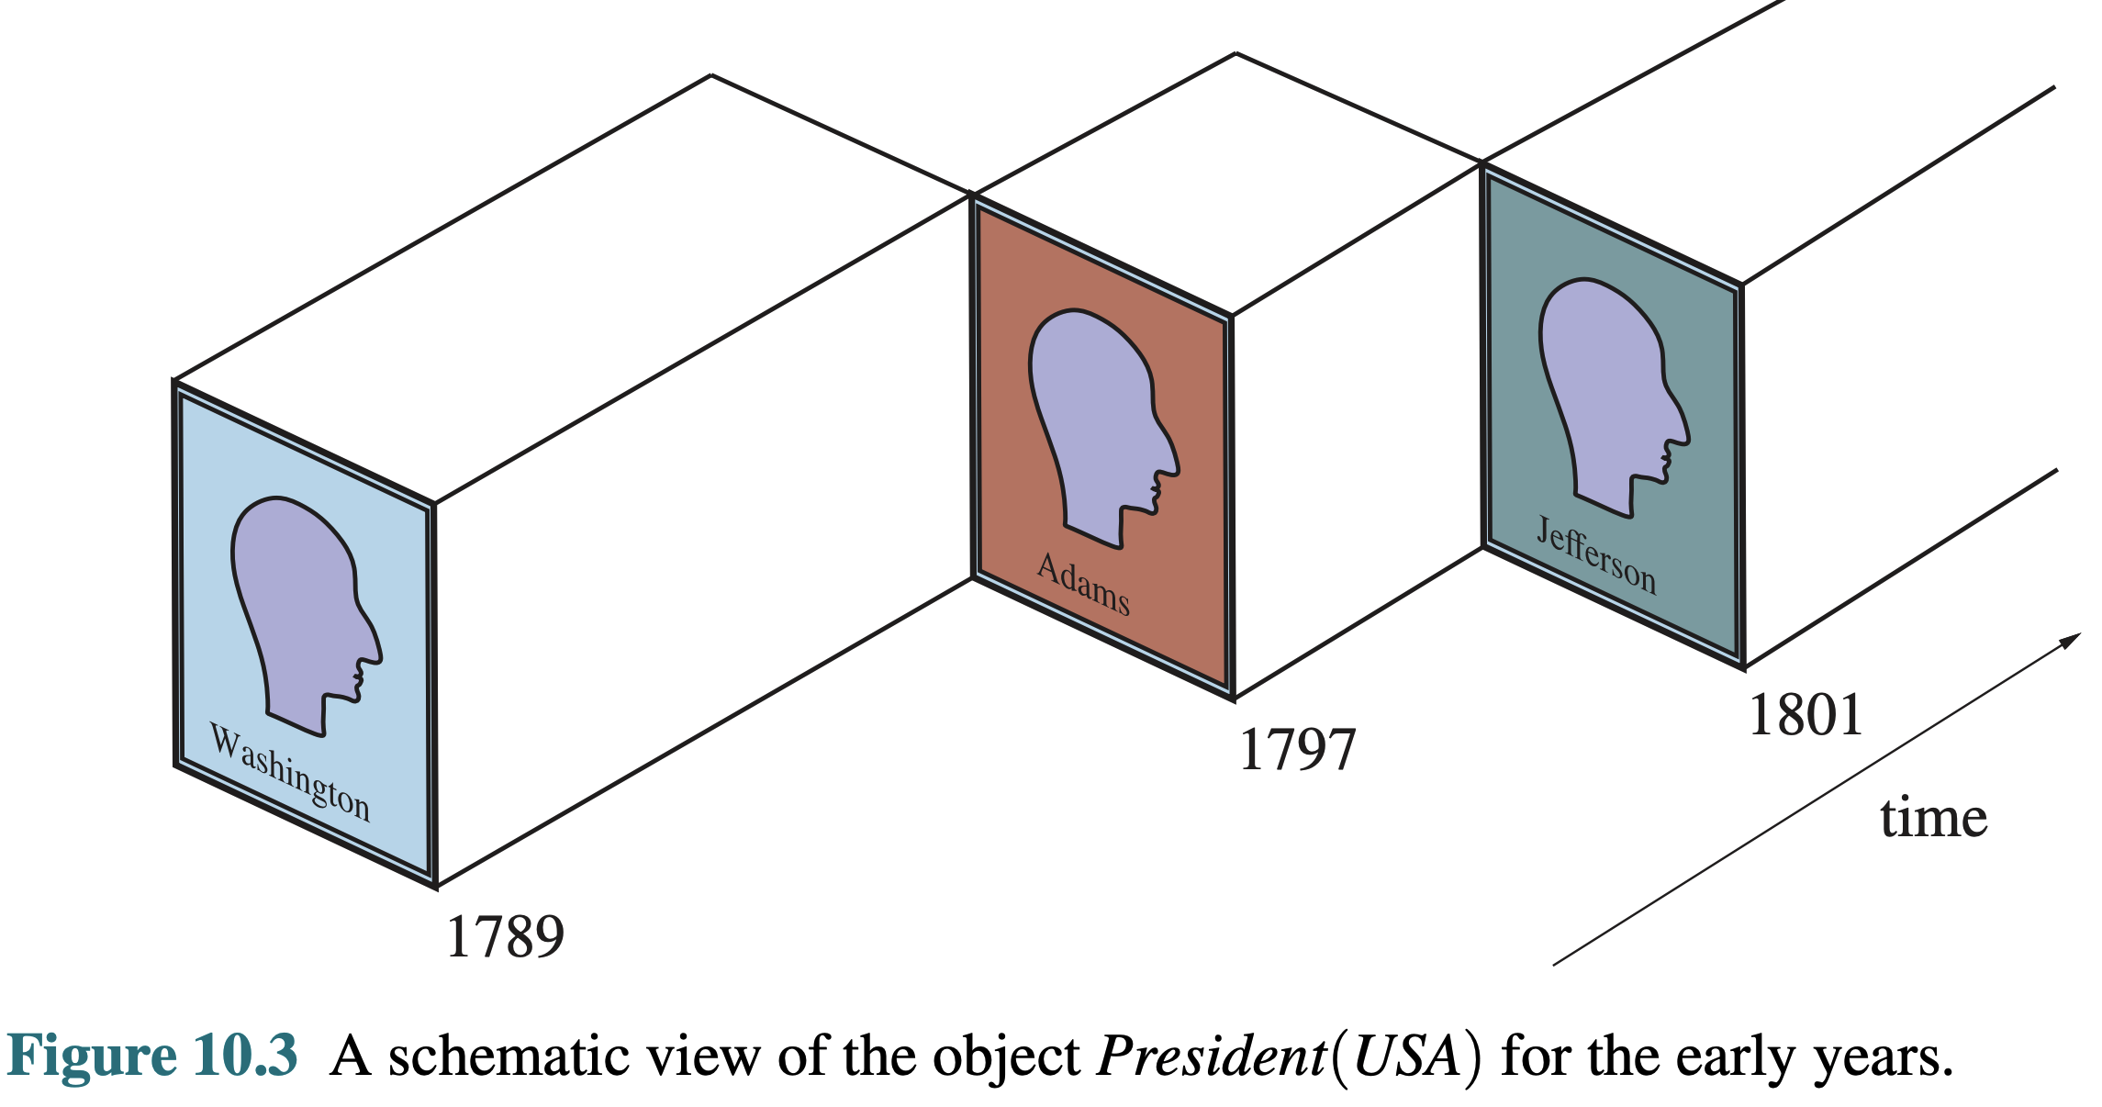
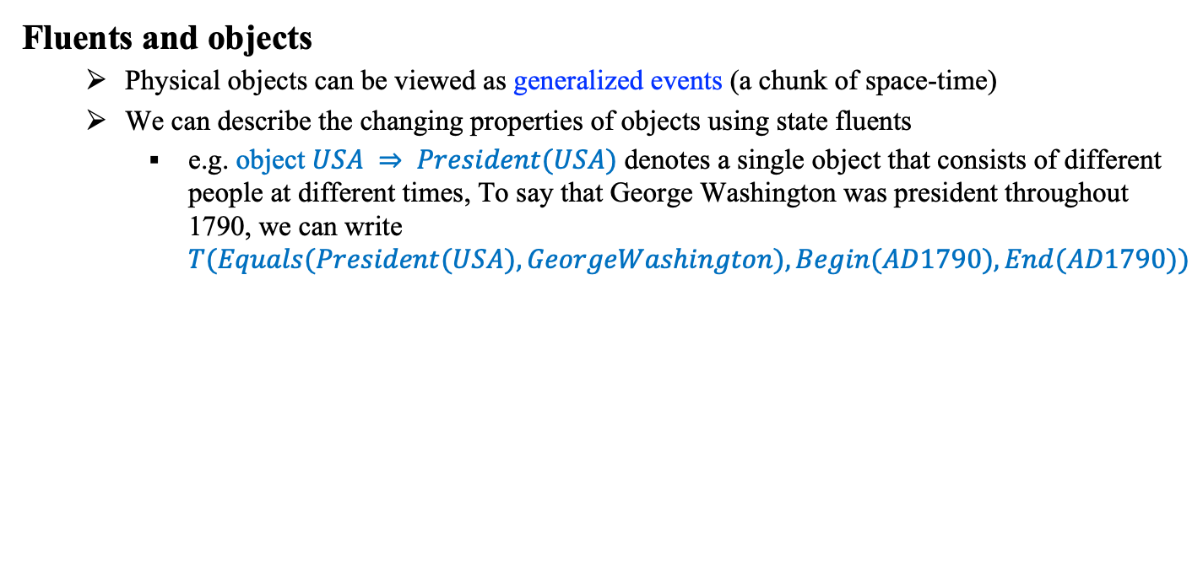
8.3 Events (3/3)
Fluents and objects
Physical objects can be viewed as generalized events (a chunk of space-time)
We can describe the changing properties of objects using state fluents
e.g. object $USA ⇒ President(USA)$ denotes a single object that consists of different people at different times, To say that George Washington was president throughout 1790, we can write $T(Equals(President(USA),GeorgeWashington),Begin(AD1790),End(AD1790))$
출처: Stuart J. Russell and Peter Norvig (2021). Artificial Intelligence: A Modern Approach (4rd Edition). Pearson

Slide 22
Script
EAT-AT-RESTAURANT Script
Props: (Restaurant, Money, Food, Menu, Tables, Chairs)
Roles: (Hungry-Persons, Wait-Persons, Chef-Persons)
Point-of-View: Hungry-Persons
Time-of-Occurrence: (Times-of-Operation of Restaurant)
Place-of-Occurrence: (Location of Restaurant)
Event-Sequence:
first: Enter-Restaurant Script
then: if (Wait-To-Be-Seated-Sign or Reservations)
then Get-Maitre-d's-Attention Script
then: Please-Be-Seated Script
then: Order-Food-Script
then: Eat-Food-Script unless (Long-Wait) when Exit-Restaurant-Angry Script
then: if (Food-Quality was better than Palatable)
then Compliments-To-The-Chef Script
then: Pay-For-It-Script
finally: Leave-Restaurant Script
Order-Food-Script
Pay-For-It-Script

Slide 23
8.4. Mental Objects and Modal Logic

Slide 24
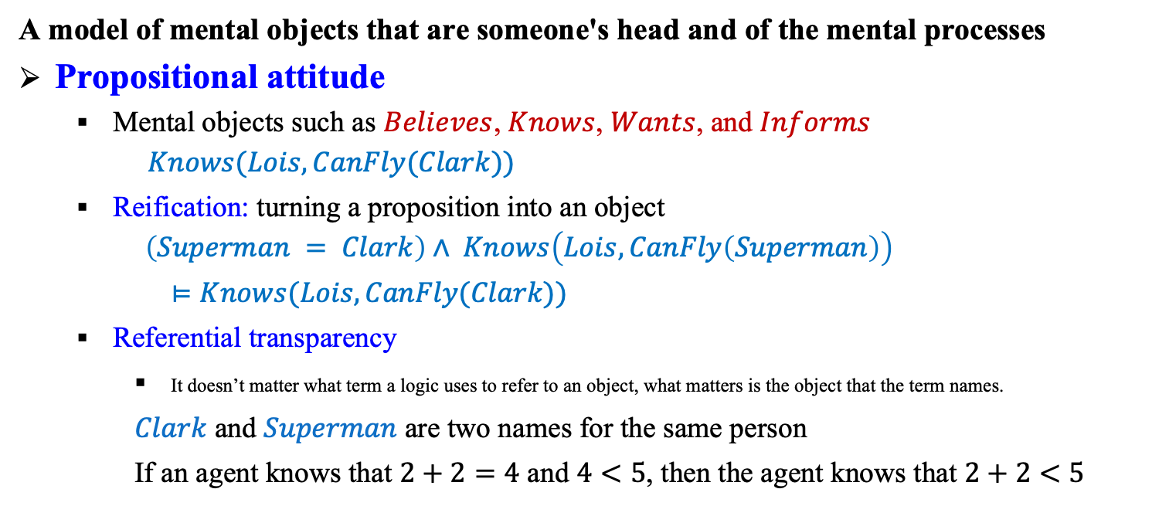
8.4 Mental Objects and Modal Logic (1/3)
A model of mental objects that are someone's head and of the mental processes
Propositional attitude
Mental objects such as $Believes$, $Knows$, $Wants$, and $Informs$
$$Knows(Lois,CanFly(Clark))$$
Reification: turning a proposition into an object $\left(Superman = Clark\right)∧ Knows\left(Lois,CanFly\left(Superman\right)\right)$
$⊨Knows(Lois,CanFly(Clark))$
Referential transparency
It doesn’t matter what term a logic uses to refer to an object, what matters is the object that the term names.
$Clark$ and $Superman$ are two names for the same person
If an agent knows that $2+2=4$ and $4<5$, then the agent knows that $2+2<5$

Slide 25
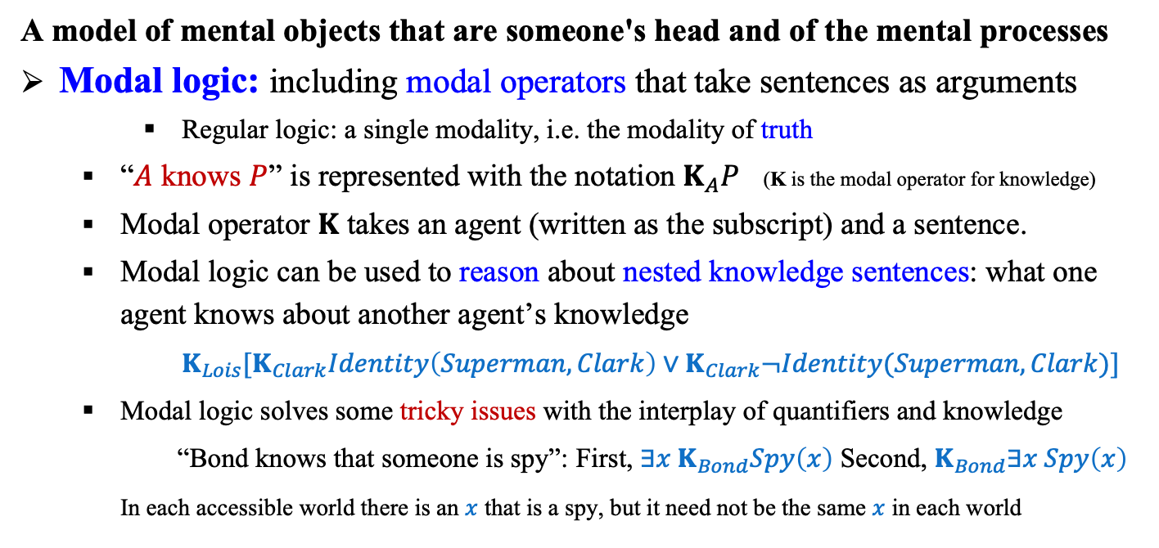
8.4 Mental Objects and Modal Logic (2/3)
A model of mental objects that are someone's head and of the mental processes
Modal logic: including modal operators that take sentences as arguments
Regular logic: a single modality, i.e. the modality of truth
“$A$ knows $P$” is represented with the notation $K_{A}P$ (K is the modal operator for knowledge)
Modal operator $K$ takes an agent (written as the subscript) and a sentence.
Modal logic can be used to reason about nested knowledge sentences: what one agent knows about another agent’s knowledge
$K_{Lois}[K_{Clark}Identity\left(Superman,Clark\right)∨K_{Clark}¬Identity(Superman,Clark)]$
Modal logic solves some tricky issues with the interplay of quantifiers and knowledge
“Bond knows that someone is spy”: First, $∃x K_{Bond}Spy\left(x\right)$ Second, $K_{Bond}∃x Spy\left(x\right)$
In each accessible world there is an $x$ that is a spy, but it need not be the same $x$ in each world

Slide 26
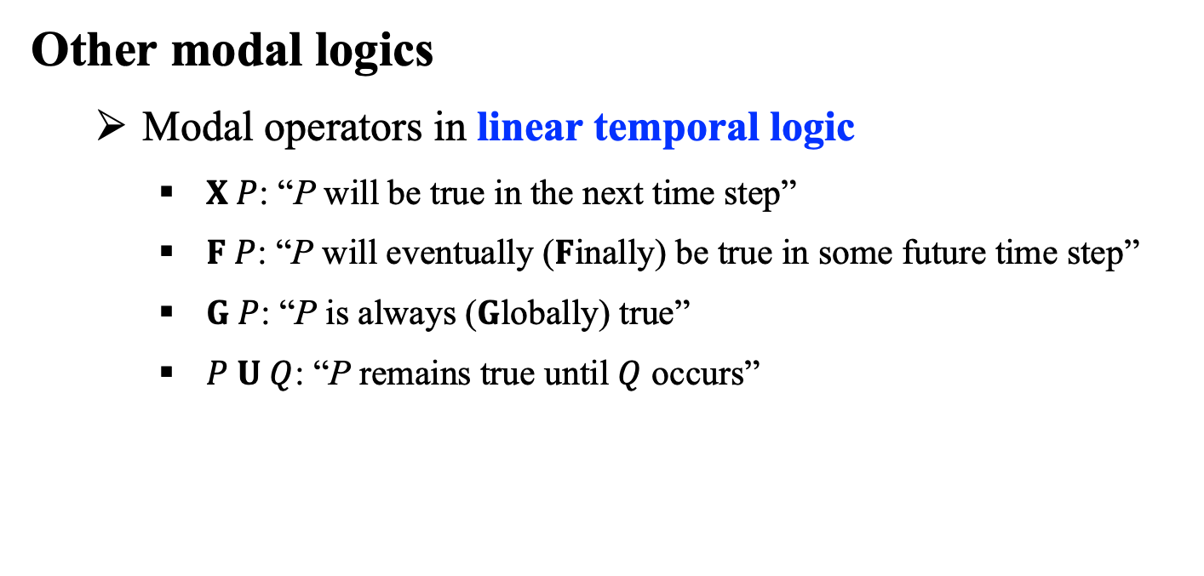
8.4 Mental Objects and Modal Logic (3/3)
Other modal logics
Modal operators in linear temporal logic
$X P$: “P will be true in the next time step”
$F P$: “P will eventually ($F$inally) be true in some future time step”
$G P$: “P is always ($G$lobally) true”
$P U Q$: “P remains true until $Q$ occurs”

Slide 27
8.5 Reasoning Systems for Categories

Slide 28
8.5 Reasoning Systems for Categories (1/6)
Two systems for reasoning with categories
Semantic Networks
Graphical aids for visualizing knowledge
Mechanisms for inferring properties of objects based on category membership
Description Logics
Formal language for constructing and combining category definitions
Algorithms for classifying objects and determining subsumption relationships

Slide 29
8.5 Reasoning Systems for Categories (2/6)
Semantic Networks
Graphical notation with underlying logical representation
A form of logic, but not first-order logic (FOL)
Capable of representing objects, categories, and relations among objects, etc.
Convenient representation of inheritance, multiple inheritance (sometimes)
Example of semantic network
출처: Stuart J. Russell and Peter Norvig (2021). Artificial Intelligence: A Modern Approach (4rd Edition). Pearson

Slide 30
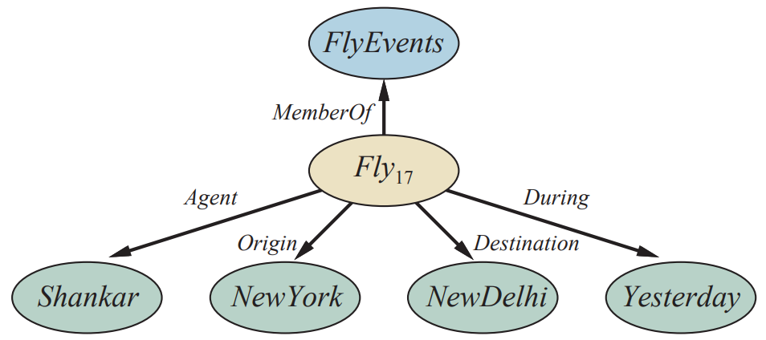
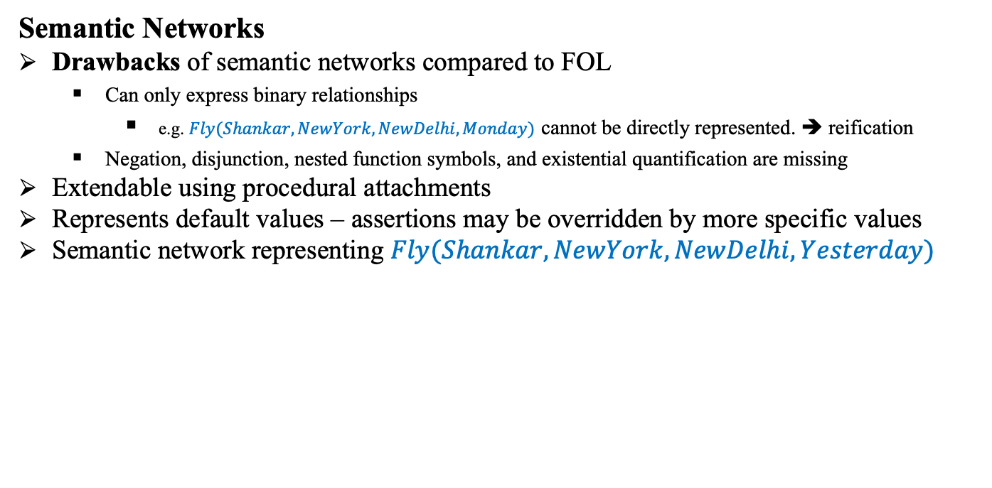
8.5 Reasoning Systems for Categories (3/6)
Semantic Networks
Drawbacks of semantic networks compared to FOL
Can only express binary relationships
e.g. $Fly(Shankar,NewYork,NewDelhi,Monday)$ cannot be directly represented. ➔ reification
Negation, disjunction, nested function symbols, and existential quantification are missing
Extendable using procedural attachments
Represents default values – assertions may be overridden by more specific values
Semantic network representing $Fly(Shankar,NewYork,NewDelhi,Yesterday)$
출처: Stuart J. Russell and Peter Norvig (2021). Artificial Intelligence: A Modern Approach (4rd Edition). Pearson

Slide 31
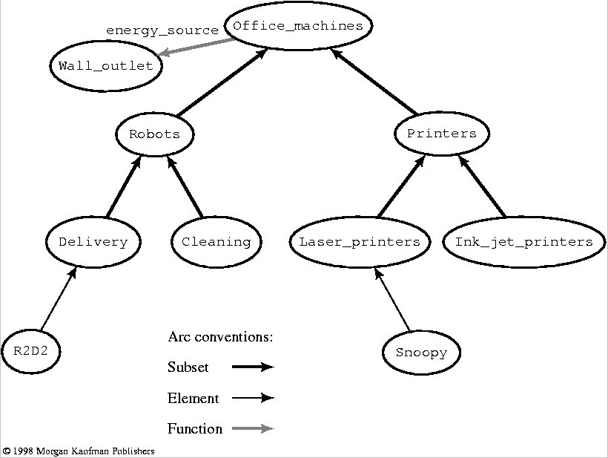
Semantic Networks
의미망 (Semantic Networks)
animal
isa
mammal
has_part
head
isa
large
size
elephant
colour
grey
instance_of
instance_of
Clyde
Nellie
likes
apples

Slide 32
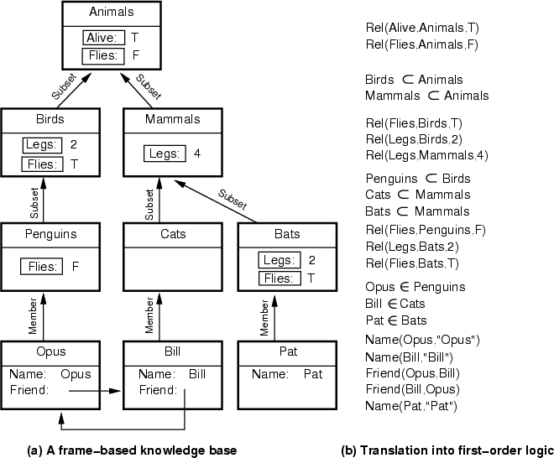
Frames & FOL
Animal
isa
has_part
Bird
isa
Wing
Robin
isa
isa
Rusty
Red

Slide 33
8.5 Reasoning Systems for Categories (4/6)
Description Logics
Notations to make it easier to describe definitions and properties of categories
FOL describes things about objects.
Evolved from semantic networks to formalize what the networks mean.
Principal inference tasks for description logics
Subsumption: Determine if one category is a subset of another
Classification: Determine the category in which an object belongs
Consistency: Determine if membership criteria are logically satisfiable

Slide 34
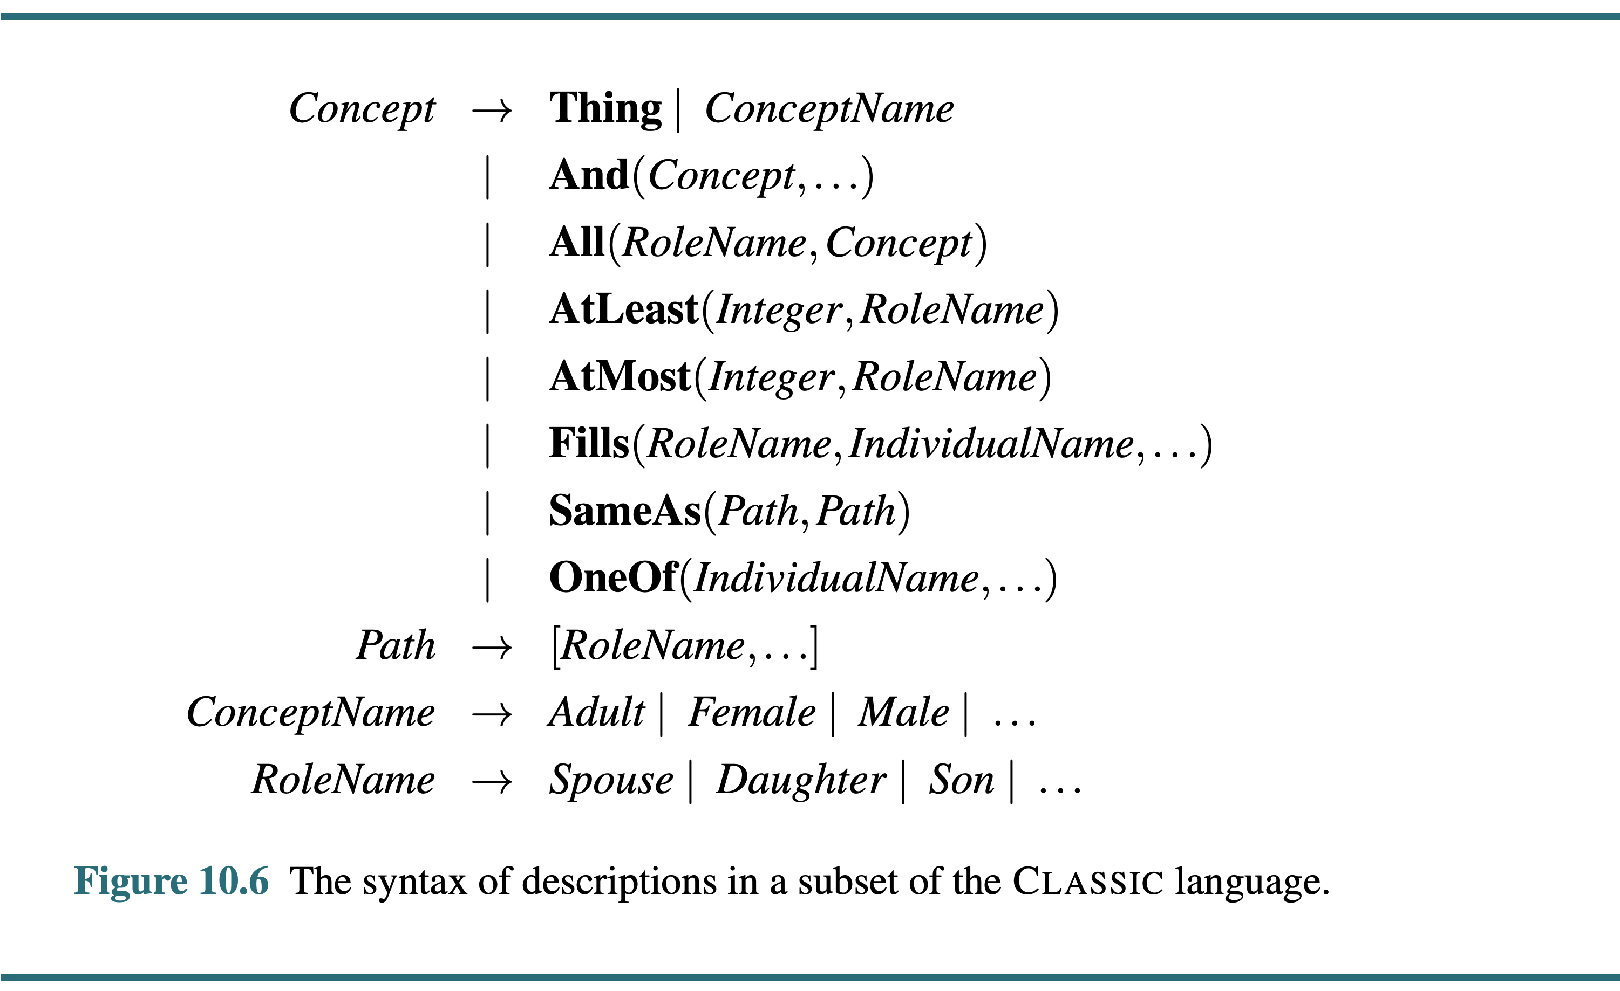
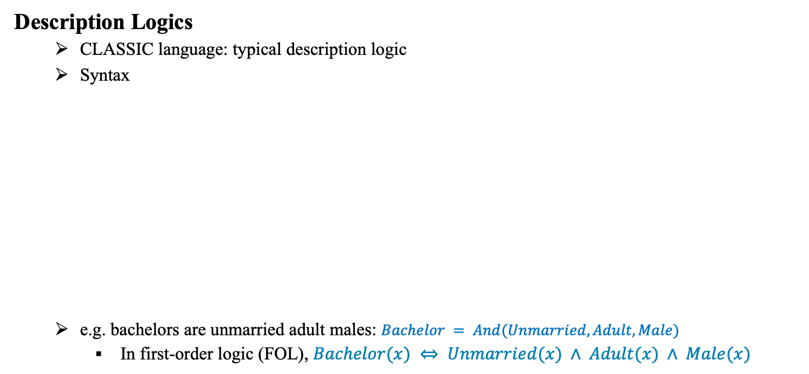
8.5 Reasoning Systems for Categories (5/6)
출처: Stuart J. Russell and Peter Norvig (2021). Artificial Intelligence: A Modern Approach (4rd Edition). Pearson
Description Logics
CLASSIC language: typical description logic
Syntax
e.g. bachelors are unmarried adult males: $Bachelor = And(Unmarried,Adult,Male)$
In first-order logic (FOL), $Bachelor(x) ⇔ Unmarried(x) ∧ Adult(x) ∧ Male(x)$

Slide 35
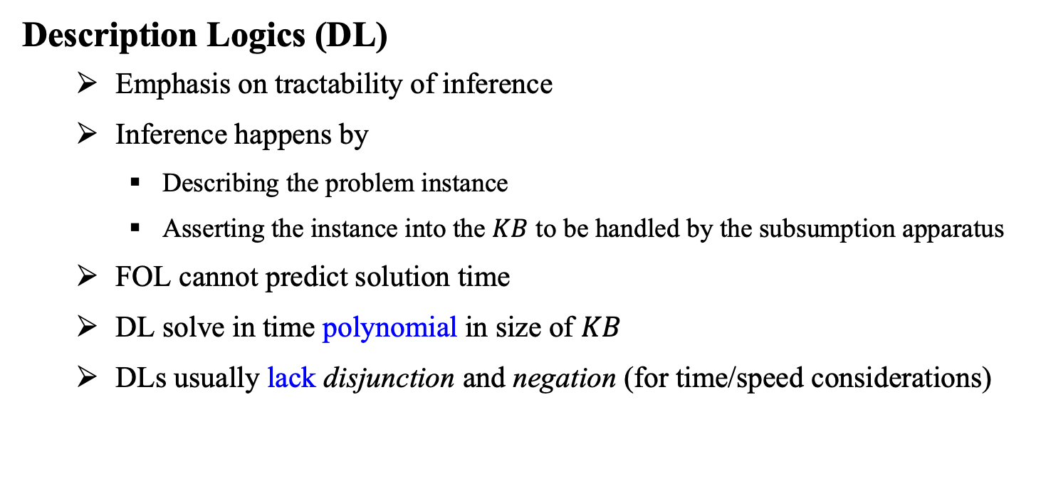
8.5 Reasoning Systems for Categories (6/6)
Description Logics (DL)
Emphasis on tractability of inference
Inference happens by
Describing the problem instance
Asserting the instance into the $KB$ to be handled by the subsumption apparatus
FOL cannot predict solution time
DL solve in time polynomial in size of $KB$
DLs usually lack disjunction and negation (for time/speed considerations)

Slide 36
8.6 Reasoning with Default Information

Slide 37
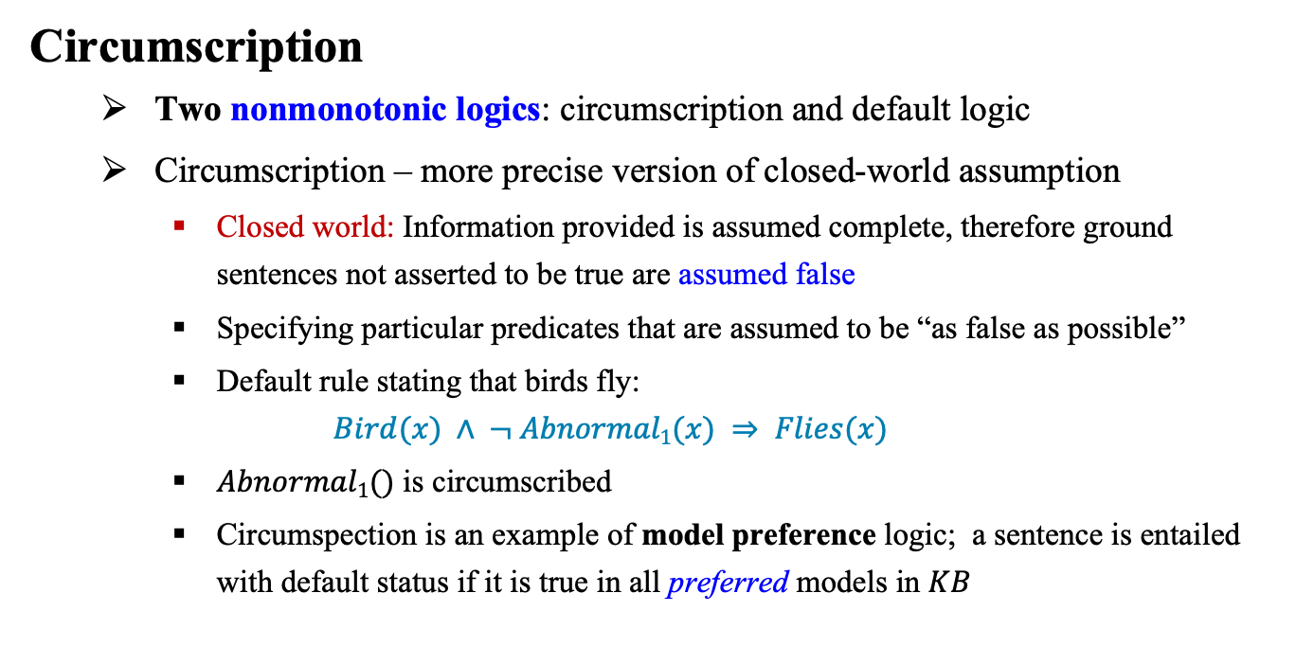
8.6 Reasoning with Default Information (1/4)
Circumscription
Two nonmonotonic logics: circumscription and default logic
Circumscription – more precise version of closed-world assumption
Closed world: Information provided is assumed complete, therefore ground sentences not asserted to be true are assumed false
Specifying particular predicates that are assumed to be “as false as possible”
Default rule stating that birds fly:
$$Bird(x) ∧ ¬ Abnormal1(x) ⇒ Flies(x)$$
$Abnormal1()$ is circumscribed
Circumspection is an example of model preference logic; a sentence is entailed with default status if it is true in all preferred models in $KB$

Slide 38
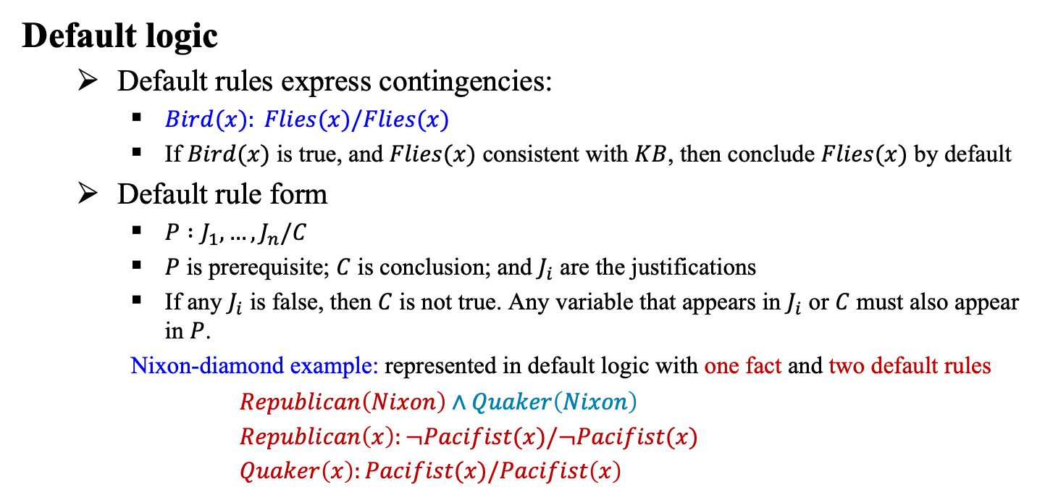
8.6 Reasoning with Default Information (2/4)
Default logic
Default rules express contingencies:
$Bird(x): Flies(x)/Flies(x)$
If $Bird(x)$ is true, and $Flies(x)$ consistent with $KB$, then conclude $Flies(x)$ by default
Default rule form
$P :J_{1}, …,J_{n}/C$
$P$ is prerequisite; $C$ is conclusion; and $J_{i}$ are the justifications
If any $J_{i}$ is false, then $C$ is not true. Any variable that appears in $J_{i}$ or $C$ must also appear in $P$.
Nixon-diamond example: represented in default logic with one fact and two default rules
$Republican\left(Nixon\right)∧Quaker\left(Nixon\right)$
$Republican\left(x\right):¬Pacifist(x)/¬Pacifist(x)$
$Quaker\left(x\right):Pacifist(x)/Pacifist\left(x\right)$

Slide 39
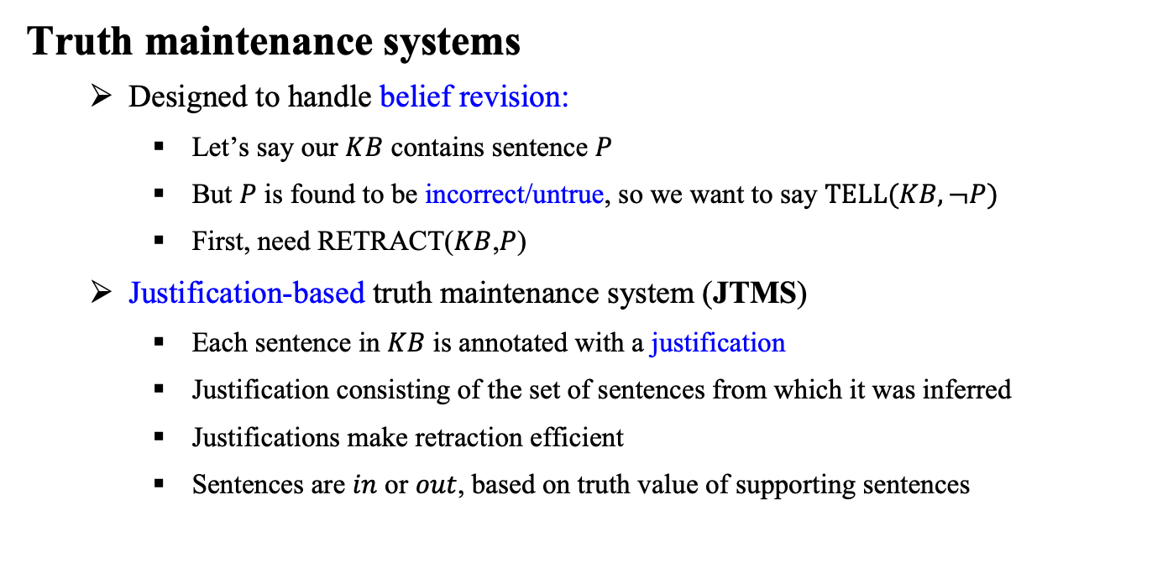
8.6 Reasoning with Default Information (3/4)
Truth maintenance systems
Designed to handle belief revision:
Let’s say our $KB$ contains sentence $P$
But $P$ is found to be incorrect/untrue, so we want to say $TELL(KB, ¬P)$
First, need RETRACT($KB$,$P$)
Justification-based truth maintenance system (JTMS)
Each sentence in $KB$ is annotated with a justification
Justification consisting of the set of sentences from which it was inferred
Justifications make retraction efficient
Sentences are $in$ or $out$, based on truth value of supporting sentences

Slide 40
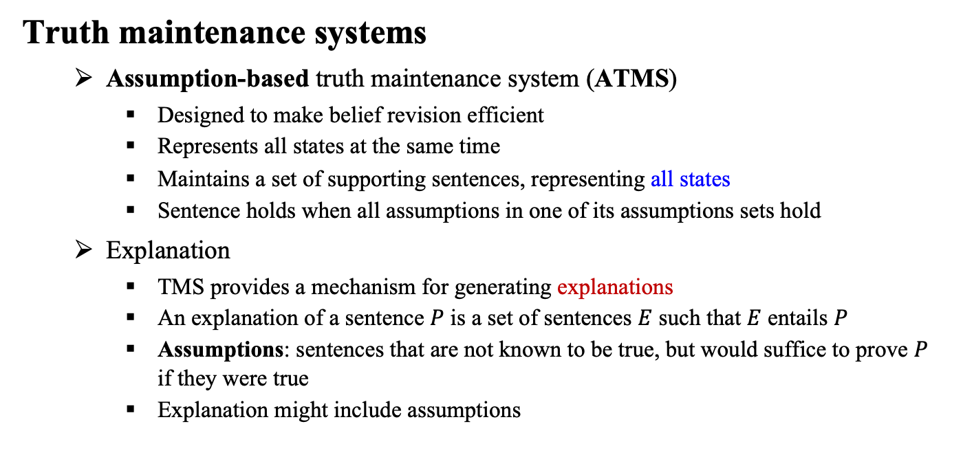
8.6 Reasoning with Default Information (4/4)
Truth maintenance systems
Assumption-based truth maintenance system (ATMS)
Designed to make belief revision efficient
Represents all states at the same time
Maintains a set of supporting sentences, representing all states
Sentence holds when all assumptions in one of its assumptions sets hold
Explanation
TMS provides a mechanism for generating explanations
An explanation of a sentence $P$ is a set of sentences $E$ such that $E$ entails $P$
Assumptions: sentences that are not known to be true, but would suffice to prove $P$ if they were true
Explanation might include assumptions

Slide 41
Summary
A general-purpose ontology needs to cover a wide variety of knowledge and should be capable, in principle, of handling any domain.
We presented an upper ontology based on categories and the event calculus.
Actions, events, and time can be represented with the event calculus.
Special-purpose representation systems, such as semantic networks and description logics, have been devised to help in organizing a hierarchy of categories.
Inheritance is an important form of inference, allowing the properties of objects to be deduced from their membership in categories.
The closed-world assumption, as implemented in logic programs, provides a simple way to avoid having to specify lots of negative information.
Nonmonotonic logics, such as circumscription and default logic, are intended to capture default reasoning in general.
Truth maintenance systems handle knowledge updates and revisions efficiently.

